Slide 1
Focus Time
CSC 431 Intro to Software Engineering, Team 14:
Felipe Flores
Tianyu Ma
Wen Li

Slide 2
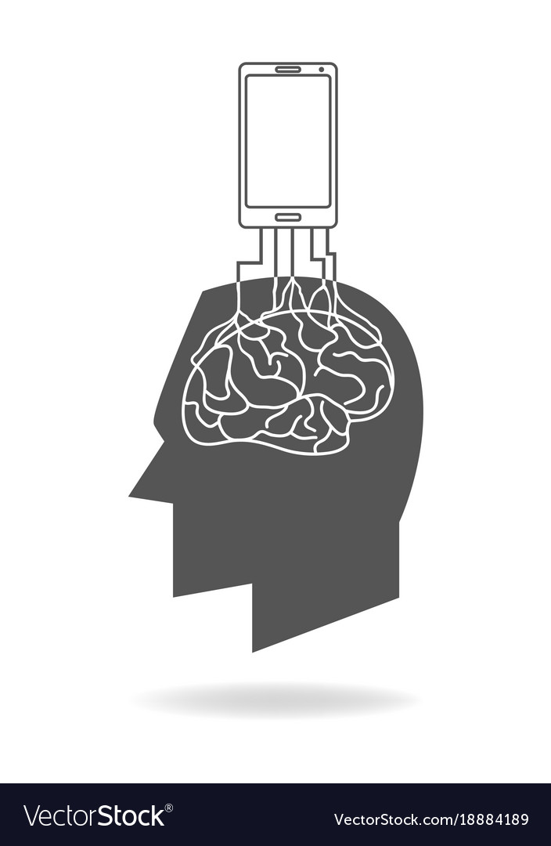
Project Review
People spend too much time getting distracted by their phones.
The purpose of this project is to provide the design of a free to download mobile application for assisting the user in staying focused for long periods of time.
The primary goal of this application is to streamline several popular techniques used to stay focus all in one app!

Slide 3
The System

Slide 4
System Overview
UI Layer: Login Form/Registration Form, TimeSet
This is the user interface which users have access to functional requirements.
Service Layer: TimeSet Manager, Database
This is the backend system which receive input from user layer
and respond with programmed result.

Slide 5
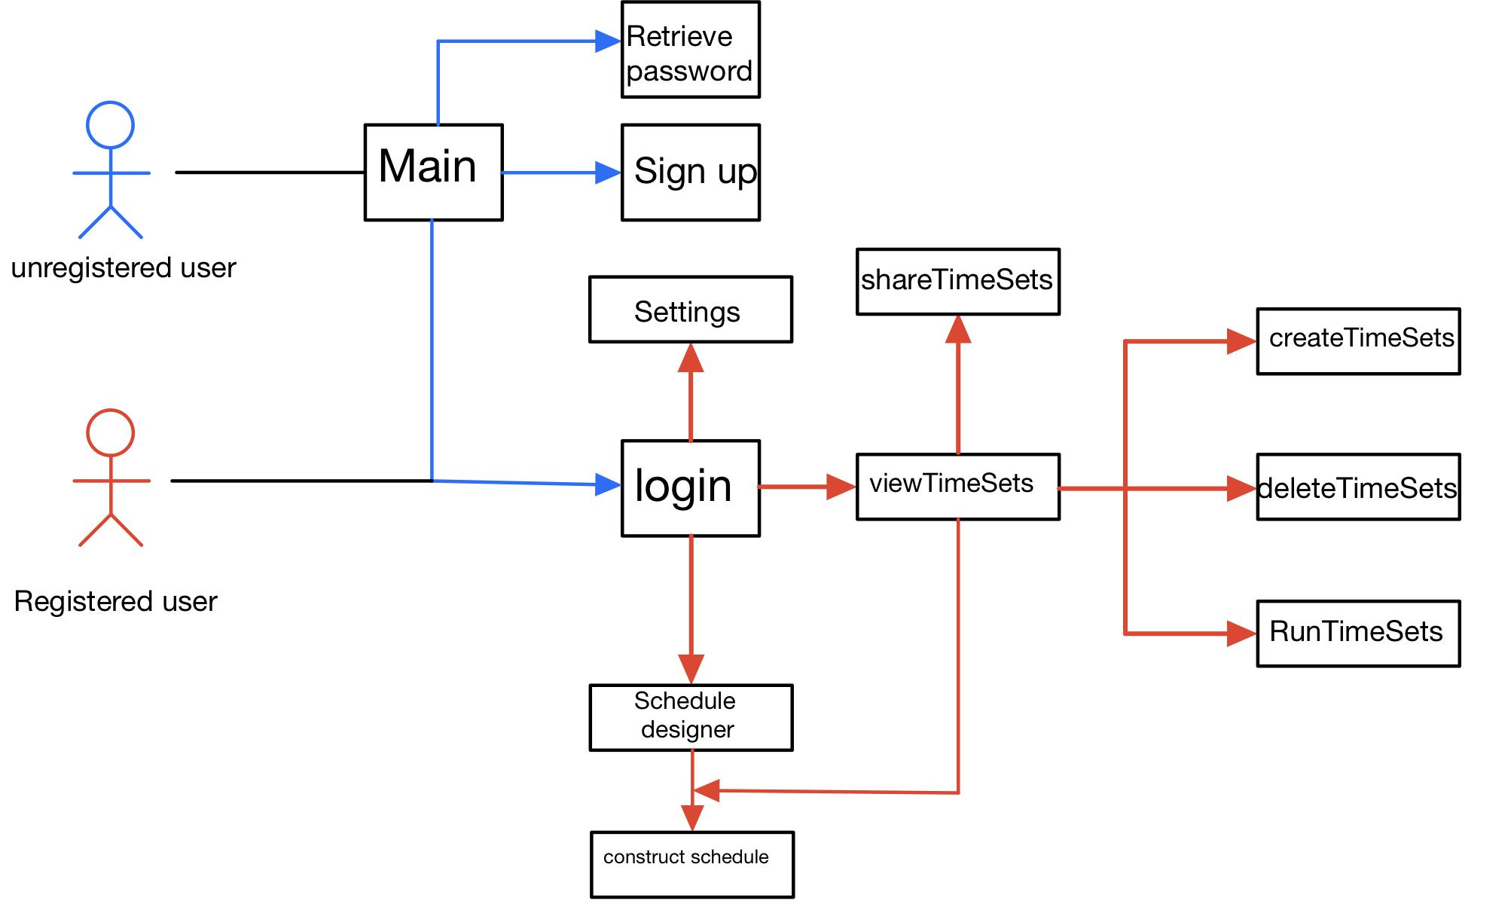
System Diagram

Slide 6
System Actors
Student/worker: It is a user(human) type of actor. A user registers on the applications’ use interface to access/add/delete/share TimeSets. The user is our primary actor because he/she initiates the interaction of the system.
Administrator: it is a system type of actor. This actor, from the external system,is a secondary actor.
Time: It is a system clock. It is the time clock of users’ mobile devices to monitor the study time of users.
Speaker: It is a system speaker. It is the speaker of users’ mobile devices to play music during TimeSets.

Slide 7
Design Rational

Slide 8
Architectural Style
Three-tier architecture style
Presentation tier: communication
Application tier: collect information & maintain logic
Data tier: store the data

Slide 9
Design Patterns
Factory method
Derived class
Store data & Encrypt data
Mediator control the communication

Slide 10
Framework
Mobile Framework: Xamarin
Programming language: C
Web Framework: Angular UI Grid
Large datasets
Grouping, Sorting and Accessing
Notes:
Can be like the previous one if the user want to
Satisfied for both Microsoft, ios and Android

Slide 11
Functional Design

Slide 12
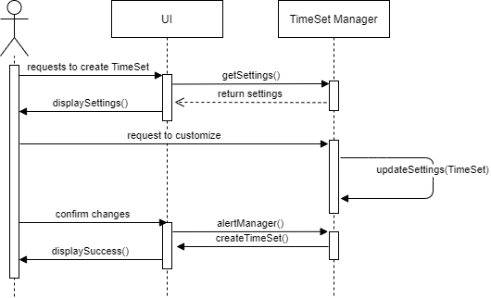
Sequence Diagram 1 (Create TimeSet)

Slide 13
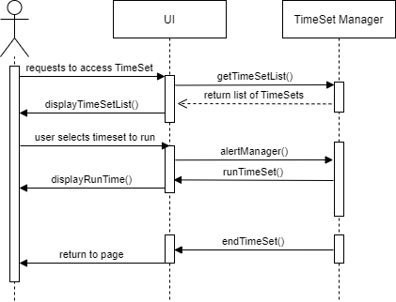
Sequence Diagram 2 (Access TimeSet)

Slide 14
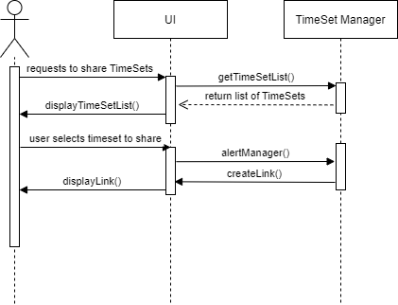
Sequence Diagram 3 (Share TimeSet)

Slide 15
Structural Design

Slide 16
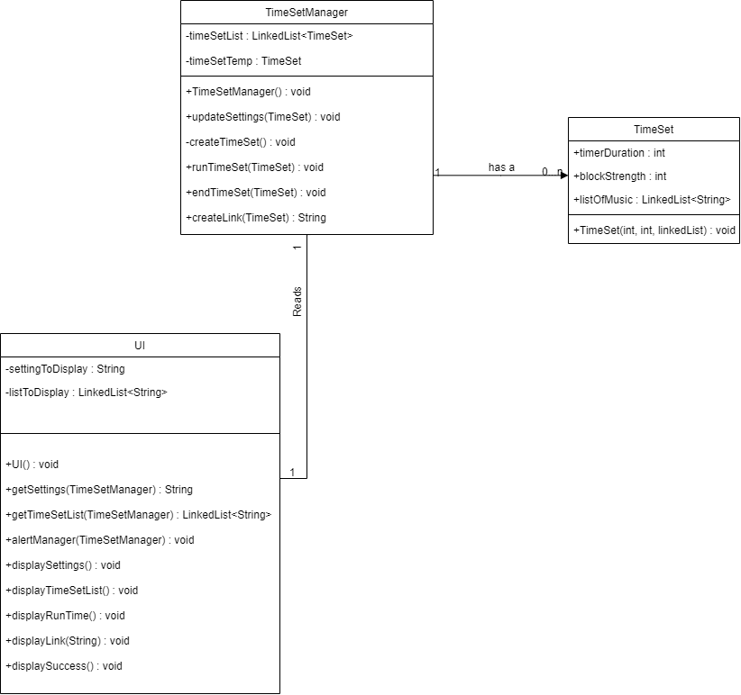
UML Class Diagram (UI, TimeSetManager,TimeSet)

Slide 17
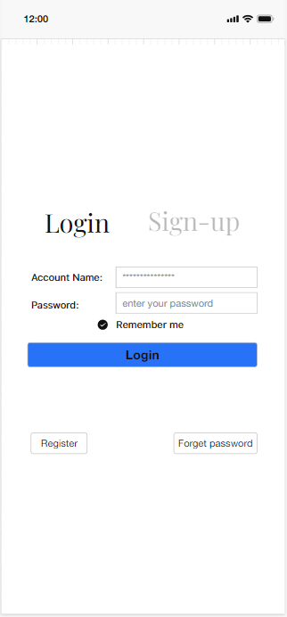
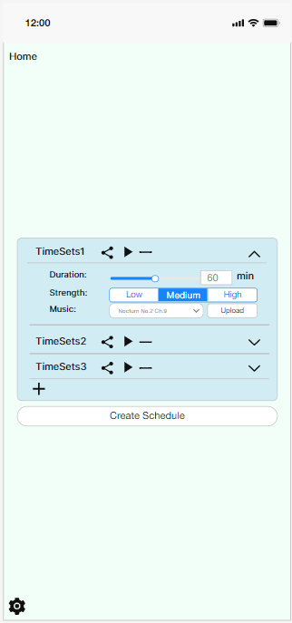
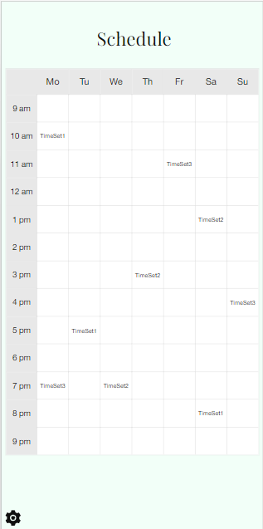
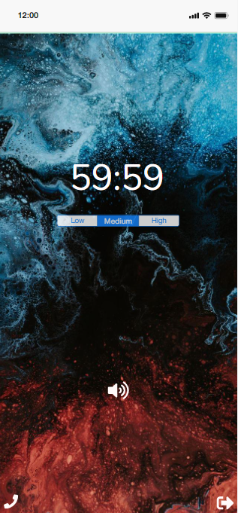
Mockup

Slide 18
Focus Time
CSC 431 Intro to Software Engineering, Team 14:
Felipe Flores
Tianyu Ma
Wen Li
https://github.com/felipefloresSC/CSC431-Group-Project

Slide 19
Citations
https://www.123rf.com/stock-photo/director_computer_user.html?sti=of87ladikjfki8jley|
https://wallhere.com/en/wallpaper/167791
https://www.shutterstock.com/video/clip-1028941868-eppelheim-baden-wurttemberg--germany---05
https://www.shutterstock.com/video/clip-1054407893-shocked-man-put-hands-on-head-very
https://gifer.com/en/B6Qs
https://www.independent.co.uk/life-style/health-and-families/mobile-phones-children-kids-a9308266.html
https://www.pewresearch.org/internet/fact-sheet/mobile/
https://www.statista.com/statistics/1224510/time-spent-per-day-on-smartphone-us/#:~:text=According%20to%20a%20survey%20conducted,average%20on%20their%20phone%20daily.
https://www.vectorstock.com/royalty-free-vector/smart-phone-rooted-in-the-human-brain-vector-18884189

